Slide 1

DESIGNING MONOLITH FIRST FOR MICROSERVICE ARCHITECTURE
Halil İbrahim Kalkan
halilibrahimkalkan.com
https://github.com/hikalkan/presentations

Slide 2
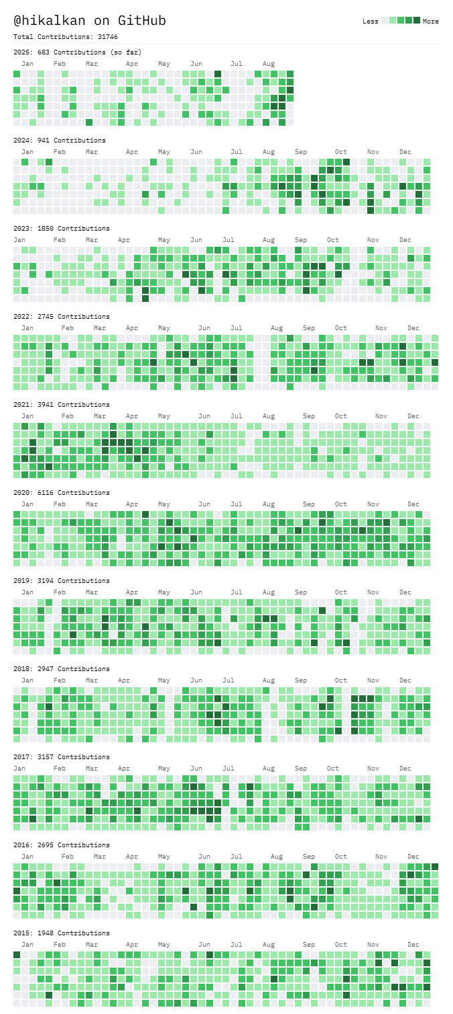







ABOUT ME: HALİL İBRAHİM KALKAN
1997, Started programming (at 14 years old, with Turbo Pascal)
2003-2007, Computer Engineering
2007 - 2015: Software developer, software architect, team leader
2013 - ∞: Lead developer of the open source ABP Framework
2016 - ∞: Co-founder, software architect
Multi-threading, distributed/microservice systems, OOP, DDD, software architectures.. etc.
Active coder, open-source contributor
30,000+ total contributions on GitHub

Slide 3

Agenda
Microservices and the monolith-first approach
Designing a modular monolith
The need for layering
Designing the database
Integrating the modules
Migrating to microservices
Hosting & distribution
Replacing in-process service calls
Enabling transactional events
Handling database migrations
Authentication and authorization changes
Deployment

Slide 4
INTRODUCTION
DESIGNING MONOLITH FIRST FOR MICROSERVICE ARCHITECTURE

Slide 5
Microservice trade-offs
BENEFITS
Forcing the modularity and encapsulation
Independently developed, deployed and scaled
Technology diversity
COSTS
Distribution
Eventually consistency
Operational complexity

Slide 6


Microservices: Who is for?
Large development team with DevOps and automation culture
Large, complex and mature business or domain

Slide 7
Microservices: Who is NOT for?
My primary guideline would be don't even consider microservices unless you have a system that's too complex to manage as a monolith. The majority of software systems should be built as a single monolithic application. Do pay attention to good modularity within that monolith, but don't try to separate it into separate services.
--- Martin Fowler

Slide 8
Monolith first: When?
YAGNI: Create a simplistic version first, maybe it won’t succeed.
Fast MVP, shorter time to market
Service boundaries & business requirements are not clear –refactoring a monolith is easier than a microservices
You’ve a small team

Slide 9
Monolith first: When not?
You are already replacing a legacy monolith or distributed system!

Slide 10
DESIGNING A MODULAR MONOLITH
DESIGNING MONOLITH FIRST FOR MICROSERVICE ARCHITECTURE

Slide 11
The need for layering
DESIGNING A MODULAR MONOLITH

Slide 12
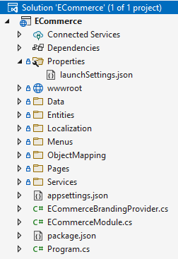
The need for layering Single-project solution
Data access logic
Business logic
Hosting logic
User interface

Slide 13


The need for layering Backend-frontend separation
Database
Data access logic
Business logic
Backend Application
Database
HTTP (REST) API
API Hosting logic
Data access logic
Business logic
API Gateway
User interface
Hosting logic
User interface
Frontend Application
UI Hosting logic
Browser / User
Browser / User

Slide 14
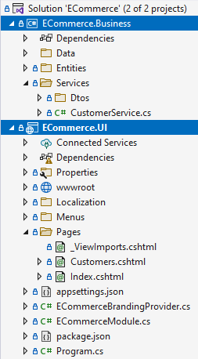
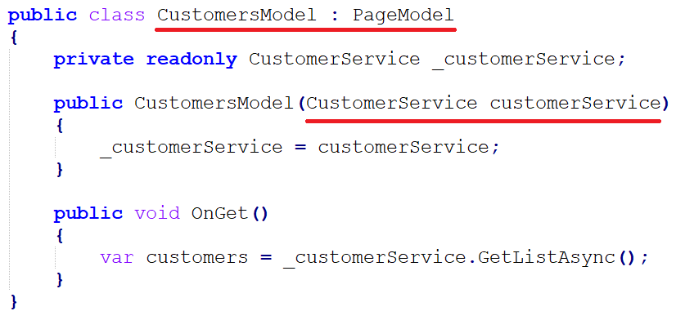
The need for layering Separating UI from business
ECommerce.UI --- (depends) ---> Ecommerce.Business

Slide 15
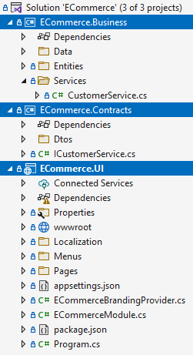
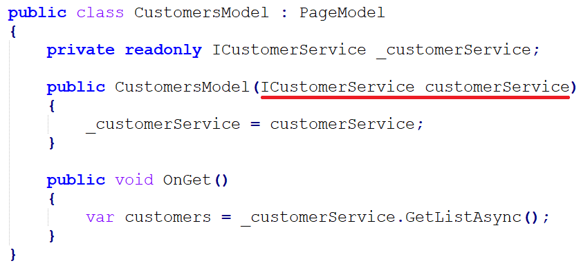
The need for layering Introducing business contracts
ECommerce.UI --- (depends) ---> ECommerce.Contracts
ECommerce.Business --- (depends) ---> ECommerce.Contracts

Slide 16
The need for layering Hosting a modular monolith
Customer module
Order module
Payment module
Basket module
Monolith Host Application

Slide 17
Designing the database
DESIGNING A MODULAR MONOLITH

Slide 18
Designing the database Single (shared) database approach
+ Easy to develop, test, deploy and maintain
- All modules should use the same database technology
- Should care about the data isolation between modules
Database
Customer module
Order module
Payment module
Basket module
Monolith Host Application

Slide 19
Designing the database Single (shared) database approach
Restrict access for each module with different connection strings, so modules can’t use other modules’ data (separate schemas)
Separate DbContext classes for Entity Framework Core
Unify EF Core database migrations
Database
Customer module
Order module
Payment module
Basket module
Monolith Host Application

Slide 20
Designing the database Separate (multiple) database approach
- Harder to develop, test, deploy and maintain
+ Every module may use the best database technology for its purpose
+ You don’t care about the data isolation between modules
HYBRID: Separate database whenever you need a different database technology for a module
Customer module
Order module
Payment module
Basket module
Monolith Host Application

Slide 21
Designing the database Common principles
Do not access to other modules’ database
Do not perform JOIN queries across different modules
Denormalize/duplicate data when needed
Asynchronously update the duplicated data if necessary
Create reporting module(s) with its own tables/databases – feed them using distributed events or replication

Slide 22
Integrating the modules
DESIGNING A MODULAR MONOLITH

Slide 23
Integrating the modules Common principles
A module should not touch other module’s internal APIs and database
Should talk with public integration APIs (synchronous communication) and distributed events (asynchronous communication)

Slide 24
Integrating the modules Synchronous communication
Create integration services
Best for read (query) operations
Don’t assume database transaction for inter-module operations
Use caching for read operations (especially for critical performance paths)
Use data duplication (and synchronization) to perform local database table JOINs
Monolith Host (single process)
Order module
Customer module
Query customer

Slide 25
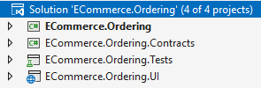

Integrating the modules Synchronous communication: project dependencies
Reference to Customers.Contracts (or Customers.Integration.Contracts) project
The monolith hosting application brings the implementations together

Slide 26
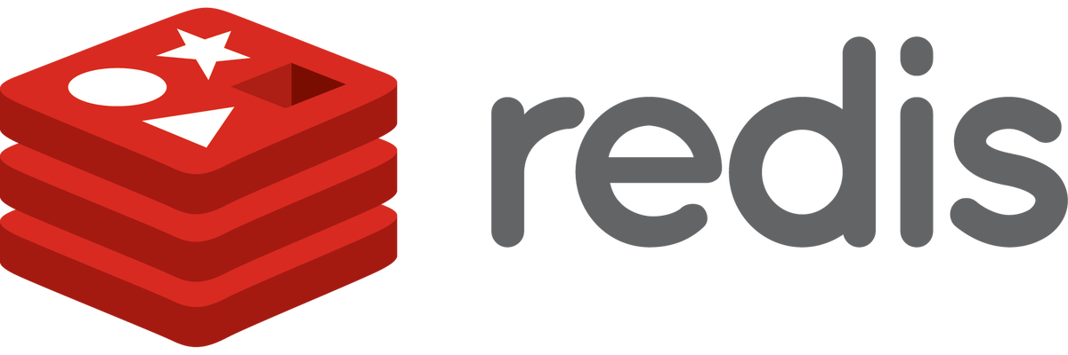
Integrating the modules Synchronous communication: caching
Monolith Host (single process)
Order module
Customer module
Query customer
Distributed cache
Not found in the cache
Invalidate the cache
Found in the cache

Slide 27
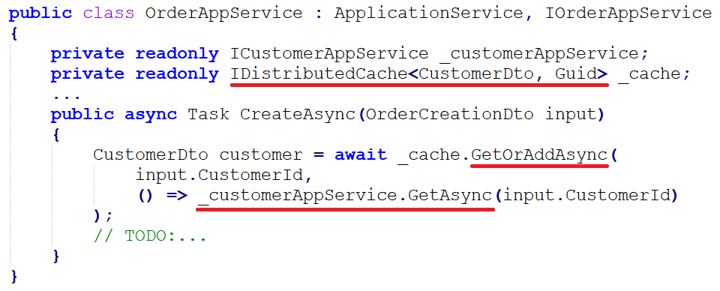
Integrating the modules Synchronous communication: caching

Slide 28
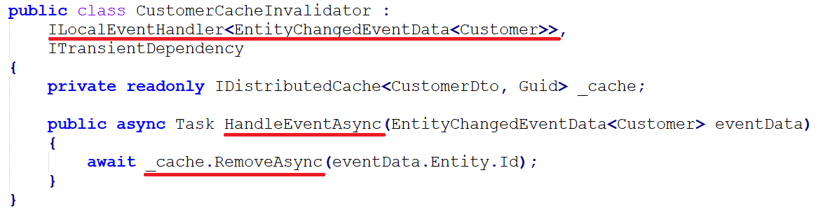
Integrating the modules Synchronous communication: caching

Slide 29

Integrating the modules Synchronous communication: data duplication
(4)
(1) Query local database
(2) Use local data
(4) Update local data
(7)
(2)
(1)
(7) Update local data
Monolith Host (single process)
Order module
Customer module
(3) Query customer (potentially use cache)
Distributed Event Bus
(6) Change event
(5) Change event

Slide 30
Integrating the modules caching vs data duplication
Caching
+ Faster & lightweight
+ Doesn’t need synchronization
- Only individual access to the cached data
- Limited offline access
Use if you only need to query individual data
Data duplication
- Slower (database operations)
- Needs synchronization
+ Individual and mass access (JOIN queries) to the duplicated data
+ Better offline access
Use if you need to query mass data
YOU CAN ALWAYS COMBINE THEM

Slide 31

Integrating the modules Asynchronous communication
Monolith Host (single process)
Microservice Host
Distributed
Event Bus
Microservice Host
Order module
Distributed
Event Bus (in-process)
Customer module
migrating to
microservices
Order service
Customer service

Slide 32
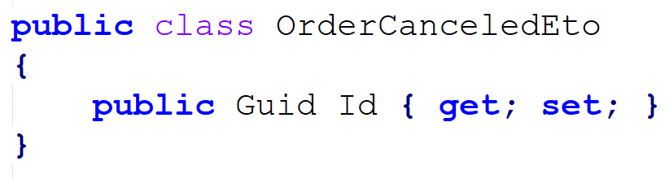
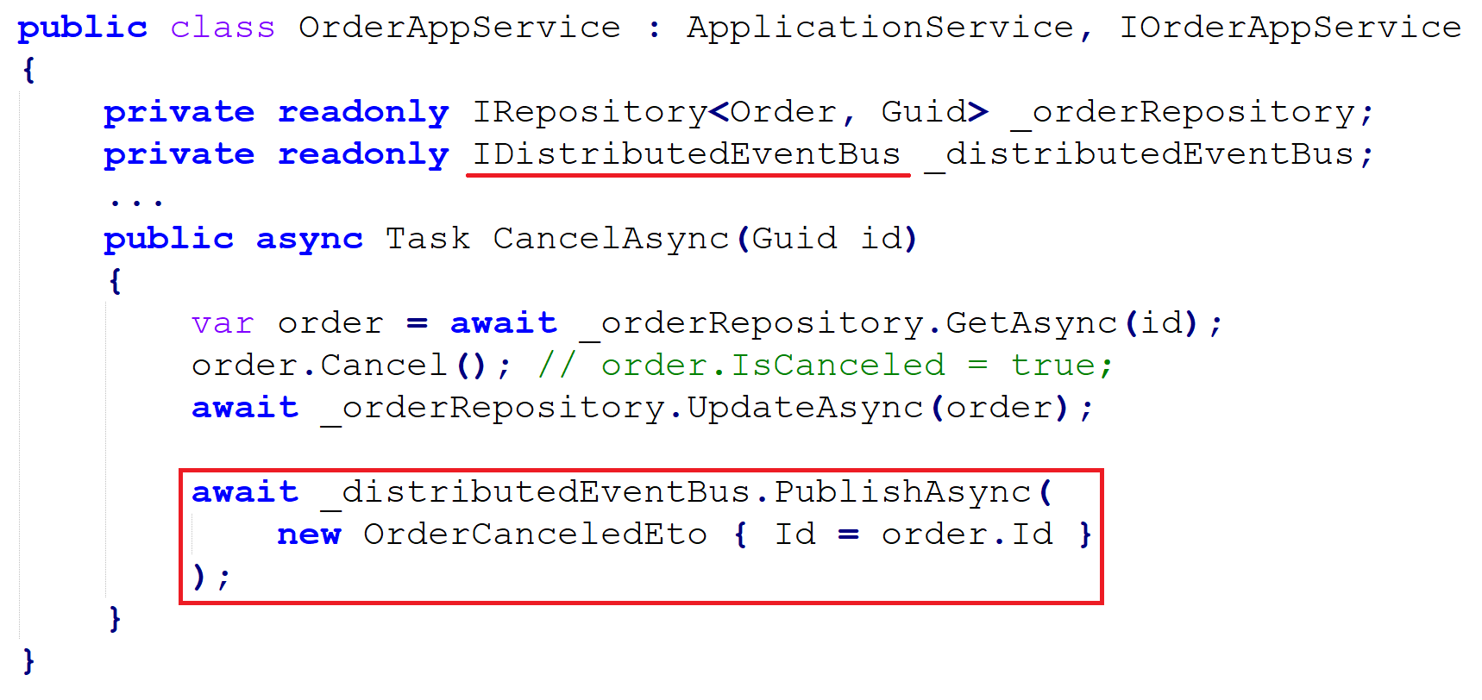
Integrating the modules ABP’s distributed event bus

Slide 33
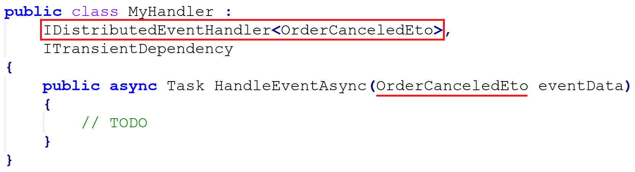
Integrating the modules ABP’s distributed event bus

Slide 34
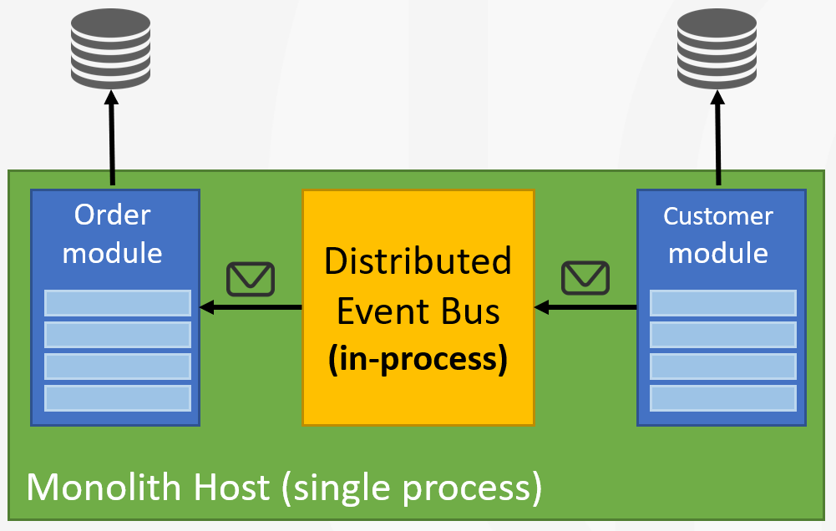
Integrating the modules Transaction & exception handling behavior
Execute the handlers in the same database transaction (unit of work)
Execute the handlers just before committing the transaction

Slide 35
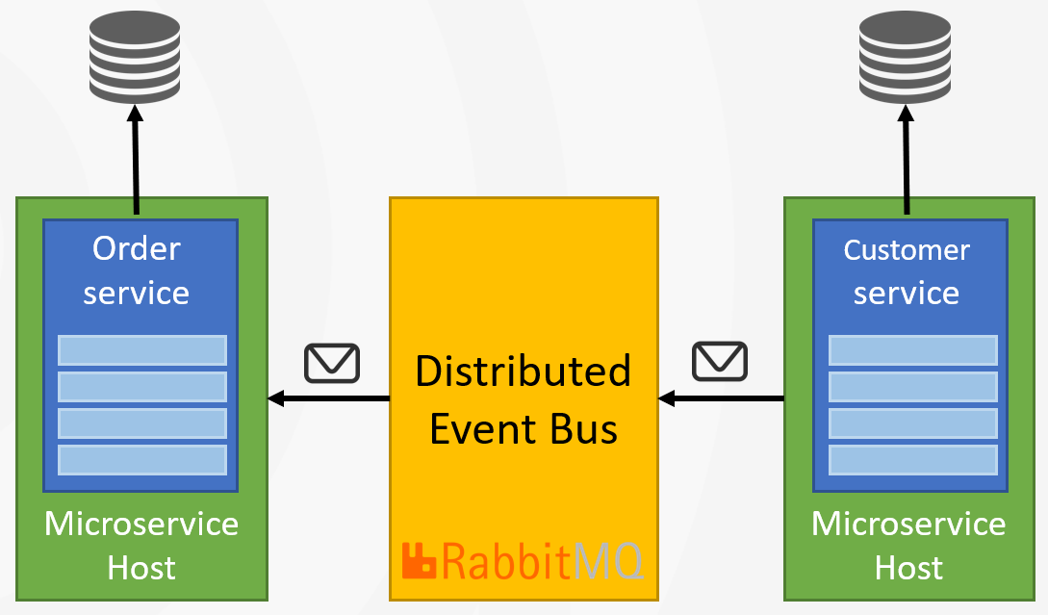
Integrating the modules Transaction & exception handling behavior
Use the outbox pattern to ensure transactional event publishing
Use the inbox pattern to ensure an event is processed only once
Use distributed locking to handle concurrency

Slide 36

Integrating the modules Transaction & exception handling behavior
Microservice A
Microservice B
event
event
ABP Event Bus
Message Broker
(RabbitMQ, Kafka, etc)
ABP Event Bus
application data
application data
re-connect
re-try
publish/subscribe
background workers
auto-events
distributed locking
outbox/inbox
outbox/inbox

Slide 37
MIGRATING TO MICROSERVICES
DESIGNING MONOLITH FIRST FOR MICROSERVICE ARCHITECTURE

Slide 38
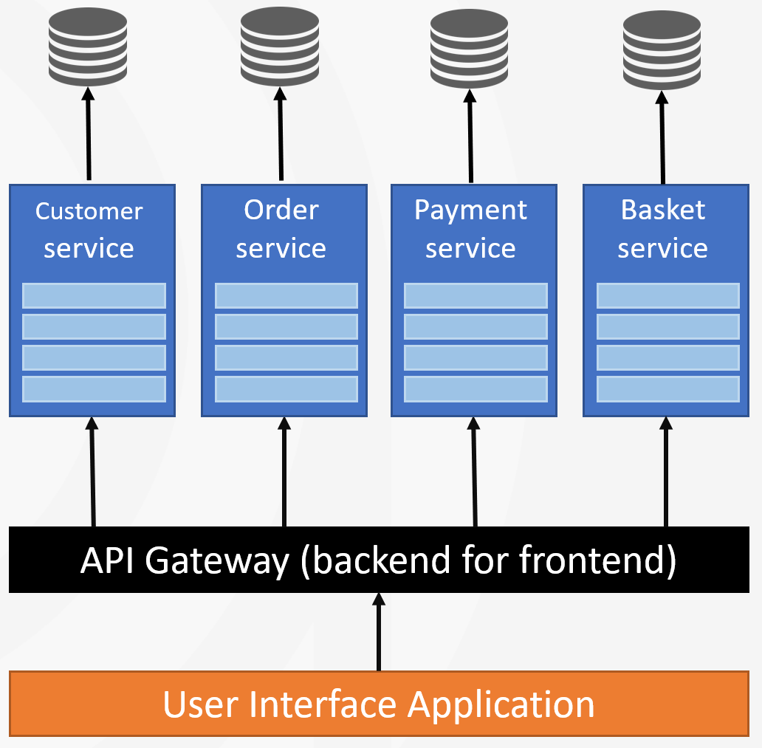
Migrating to microservices Hosting
Create a microservice host application for each module (or group modules into microservices)
Create an API gateway application (or use an external service)
Create a UI hosting application that consumes the API gateway
Configure the authentication

Slide 39
Migrating to microservices Distribution
Switch to distributed caching Volo.Abp.Caching.StackExchangeRedis
Switch to distributed messaging Volo.Abp.EventBus.RabbitMQ

Slide 40
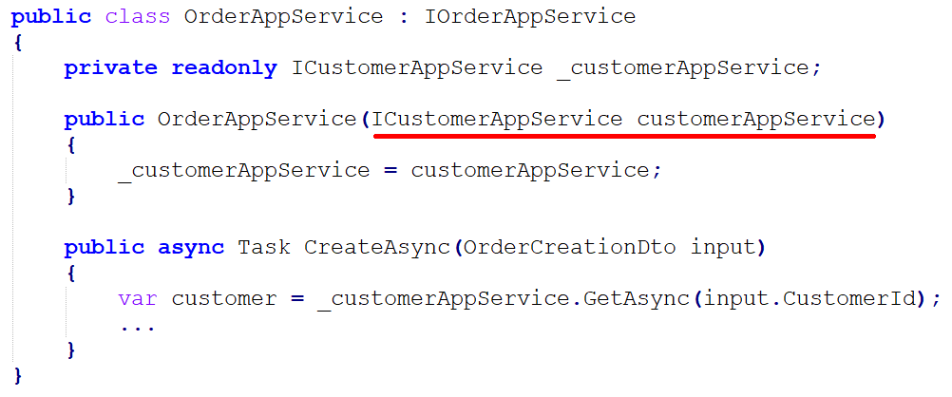
Migrating to microservices Replacing in-process service calls: abstracting

Slide 41
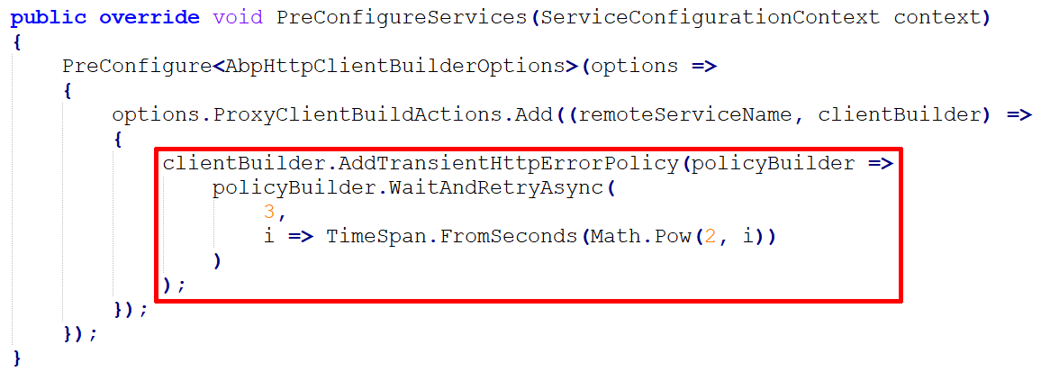
Migrating to microservices Replacing in-process service calls: retry policies

Slide 42
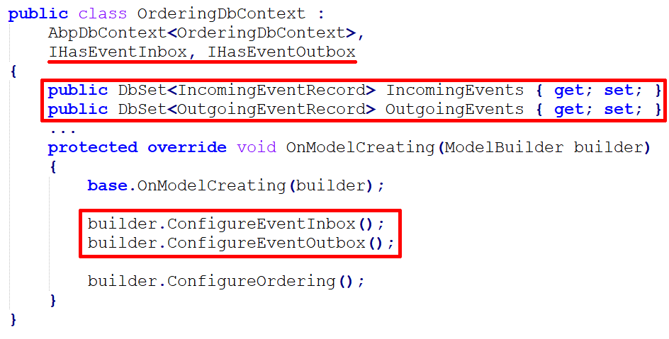
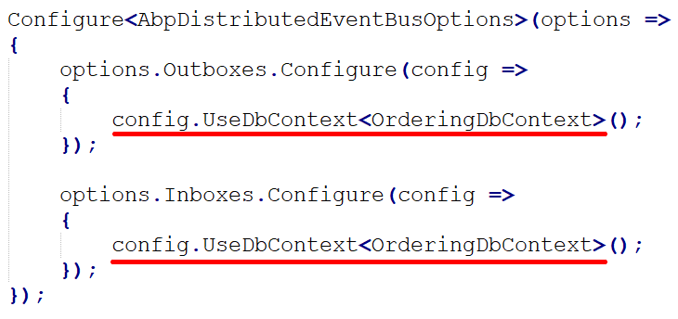
Migrating to microservices Enabling outbox & inbox for transactional events

Slide 43
Migrating to microservices Handling database migrations: monolith
The main DbContext unifies the database migration path
Every module has its own data seeder & ABP executes all of them
A separate DbMigrator console application
Customer module
Order module
Payment module
Basket module
Monolith Host Application

Slide 44
Migrating to microservices Handling database migrations: microservices
Every service migrates its own database on startup & seeds its own data
Uses distributed locking for concurrency control

Slide 45

Migrating to microservices Authentication & authorization: monolith
login
Monolith Host Application
User Interface / API
Customer module
customer database
authentication cookie
inter-module
API calls
Browser
HTTP request
cookie with claims
Order module
order
database
permission/policy
database

Slide 46
Migrating to microservices Authentication & authorization: microservices
login
Authentication server
authentication cookie
User Interface / API
API Gateway
Customer service
customer database
HTTP Request
HTTP header
with claims
inter-service
API calls
HTTP Request
HTTP header
with claims
Browser
HTTP request
cookie with claims
Order service
order
database
permission/policy
database

Slide 47
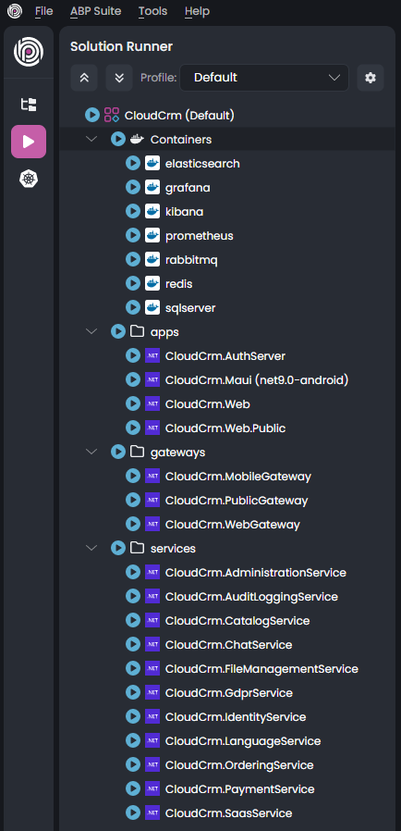
Migrating to microservices Development environment
Run all the services, databases, API gateways, etc.
Useful tools
.NET Aspire
ABP Studio
Docker / docker-compose
Custom scripts

Slide 48
Migrating to microservices Deployment
Setup a continuous deployment pipeline
Tools: Jenkins, Azure DevOps, etc.
Use a container orchestration tool
Tools: Kubernetes with Helm configuration
Configure a central logging system
Tools: Elasticsearch with Kibana UI
Setup a monitoring system
Tools: Prometheus with Grafana UI

Slide 49

DEMO https://github.com/abpframework/modular-monolith-demo
LIVE DEMO

Slide 50

References / further reading
THANKS!
DESIGNING MONOLITH FIRST FOR MICROSERVICE ARCHITECTURE
download presentation
ABP
https://abp.io
https://docs.abp.io
https://community.abp.io
Martin Fowler’s website
https://martinfowler.com
https://martinfowler.com/articles/microservice-trade-offs.html
https://martinfowler.com/bliki/MicroservicePremium.html
https://github.com/hikalkan/presentations

